Slide 1
Deferred Rendering
Specifically: Deferred Shading

Slide 2
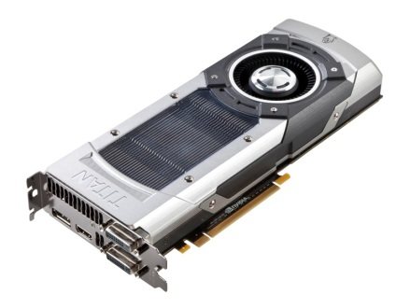





Forward rendering
The kind of rendering we’ve been doing
Light each object as it is rendered
Must provide all light information
(Or at least all potential light contributors)
+

Slide 3
Issue: Instructions
Limited by max # of instructions in a shader
A hard limit on amount of lights per shader
This happens if your light loop gets unrolled
Could force loops to actually loop
Too many “lights per object” still bad
More lights = slower shader
Optimized engine might only send in lights which could actually affect the object

Slide 4

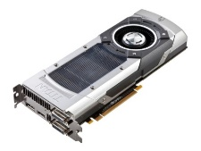




“Solving” instruction limit
Multi-pass lighting
Draw everything multiple times
Each time, calculate a different subset of lights
Additively combine results
+
+
+

Slide 5
Multi-pass lighting problems
Decent, but…
Performance issues
Each pass re-samples textures, normal maps, etc.
Basically rendering each frame multiple times
Potential for wasteful calculations
It’s an old-school solution
Doom 3 used multi-pass lighting
http://fabiensanglard.net/doom3/renderer.php

Slide 6
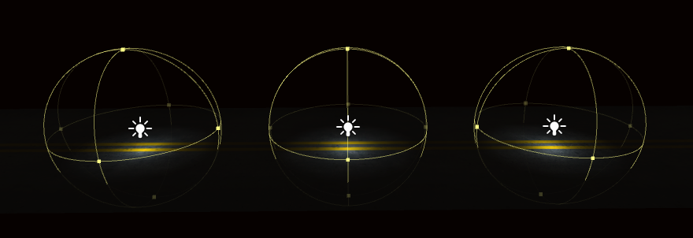
Issue: Wasteful calculations
One object (road) with 3 lights affecting it
None of the lights overlap
Light attenuates before reaching others
But all three lights processed for each pixel!

Slide 7
Wasteful calculations
Some lighting calculations are unnecessary
The pixel may be outside the light’s range
Due to attenuation (light falloff over distance)
C++ side optimizations could help a little
Light contribution ends up being zero
Surfaces in range but facing the wrong way
Surface may get covered by future draws

Slide 8
Forward rendering limits
Long ago, the magic number was 8 lights
Fast enough to calculate in real time
Didn’t hit shader instruction limits
Great for old, fixed-function GPUs
Modern games need more lights
But we can’t infinitely “add more lights”
Or things slow down tremendously
We need a different approach to lighting

Slide 9
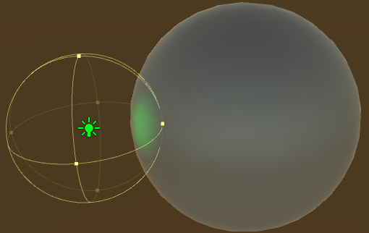
What we currently do…
N objects and M lights = O(N * M)
Can potentially be optimized per object
But still lots of wasteful calculations:
This light must be calculated for all of these pixels

Slide 10
What we’d like to do…
Only shade pixels within light’s bounds
Can calculate light’s bounds based on attenuation
Can we only perform calculations on pixels inside the bounds?

Slide 11
Light bounds & calculations
Don’t we have to run the calculation to determine if the calculation should be run?
Yes, partially
Need to calc distance and attenuation
Not the full calculation, but still costly
And may necessitate branching
Hence why a different approach is necessary

Slide 12
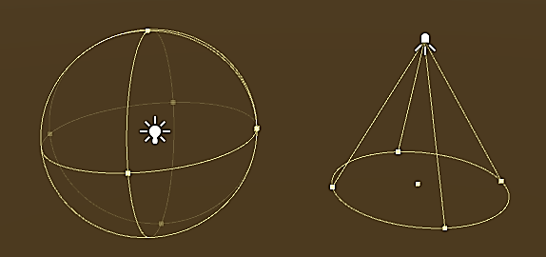
A different approach to lighting?
What do we want to do?
Only shade pixels inside a light’s bounds
Invoke pixel shader for pixels “inside” light
Can we run a pixel shader in a certain shape?
And what “shape” is a light’s bounds?

Slide 13
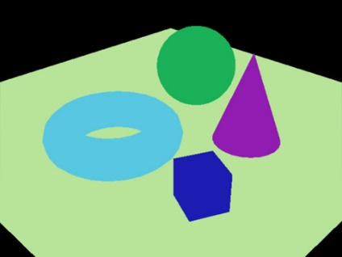
A different approach!
Let’s say we rendered geometry
But with no light information
Just the surface colors (albedo)
Then we rendered shapes matching our lights
Each “light shape” represents the pixels that light could potentially influence
This doesn’t look right
(Yet)

Slide 14

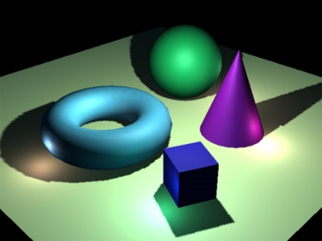
The basic idea
When we render the “light shape”
Don’t return the color of the shape itself!
Simply run the regular light calculation…
…for the geometry behind the sphere

Slide 15
Aren’t we missing something?
How do we do a light calculation without…
Normals? Positions? Shininess?
The geometry the light should affect?
Well…we don’t. We need that stuff too.
Have to pre-render that as well
Don’t pass lights into geometry render
Pass geometry info into light render! (sort of)

Slide 16
De-coupling geometry & light
What does it mean to render geometry without any lighting/shading?
Just the surface colors?
What about normals?
World position?
To light it later, we need all of that!
Render out a bunch of information
So we can use it for a later render
Sounds kind of like post-processing

Slide 17

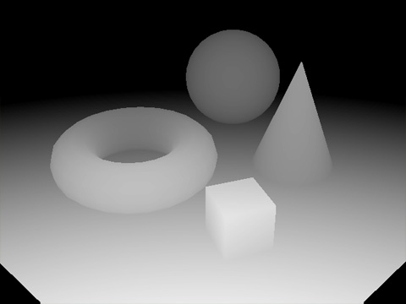
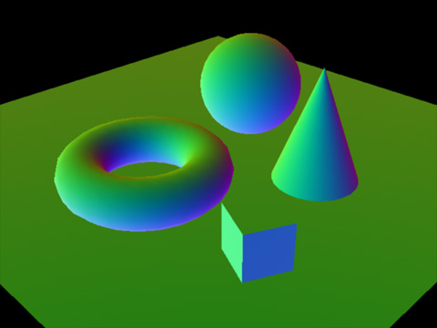
Gathering surface information
Render the following attributes to textures:
Diffuse Color (Albedo)
Depth
Normals
And possibly more
Too much data for a single texture
Multiple Render Targets to the rescue!

Slide 18
Render lights “on top”
Once we have the scene geometry info
We need to render the lights
How do you “render” a light? Need some triangles!
We want the bounds of a light’s influence
What are the possible pixels the light could “touch”?
Only run a pixel shader for those particular pixels
We need the shape and size of the light
Plus its color, attenuation, world position, etc.

Slide 19
Light shapes
What shape is a point light?
Basically a sphere
What shape is a spot light?
Basically a cone
What shape is a directional light?
It hits every pixel on the screen
Full-screen quad

Slide 20
Why is this a better approach?
Lighting calculations can get expensive
Only want to do them on pixels “within range”
And pixels that won’t get covered up later
Can determine pixel-perfect light bounds
Minimal amount of work → max performance

Slide 21
Deferred shading
Waiting to do shading calculations of a scene until the entire scene has been rendered.
Hence the “deferred” part
Forward rendering complexity:
O(geometry * lights)
Deferred shading complexity:
O(geometry + lights)

Slide 22
Deferred shading
Requires the entire scene before lighting
Albedo – float3
Normals – float3
Position – float3
Other material data
Too much info to store in a single texture
Need to split info across multiple textures
Seems expensive to re-render the scene multiple times…

Slide 23
Multiple render targets
DirectX supports Multiple Render Targets
DirectX 11 can support up to 8 MRTs at once
A pixel shader can output multiple colors
Create a struct of output colors
Each color (data) goes to a different render target
Render the scene once, get multiple textures!

Slide 24
MRT output struct example
struct PSOutput
{
float4 color : SV_TARGET0;
float4 normals : SV_TARGET1;
float4 worldPos : SV_TARGET2;
}
PSOutput main()
{
// Your pixel shader function
}

Slide 25
Geometry buffer (G-Buffer)
The name for the group of textures that represent the geometry and material properties of each pixel on the screen
This is NOT a special DirectX/GPU thing!
This is literally just a bunch of textures
Which hold information about your geometry
Fancy terminology for “all of these textures”

Slide 26
Geometry buffer contents
Different engines and different approaches may require different types of G-Buffer info
Basics
Normals
Albedo (color)
Depth
World Position (can re-calc using depth & view matrix)
Other possible components
Specular color, power, intensity
Glow
Sub-surface scattering

Slide 27
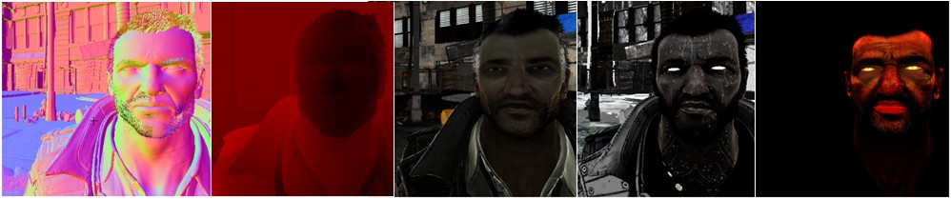
Geometry buffer examples
From Epic Games GDC 2011 tech demo
http://udn.epicgames.com/Three/DeferredShadingDX11.html

Slide 28
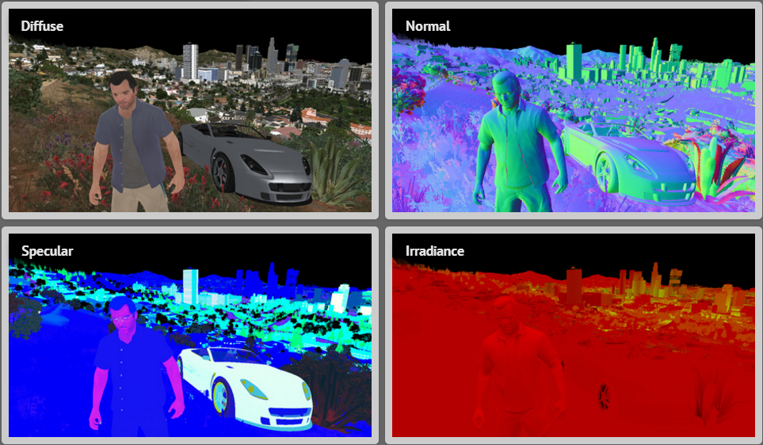
Geometry buffer examples
GTA 5

Slide 29
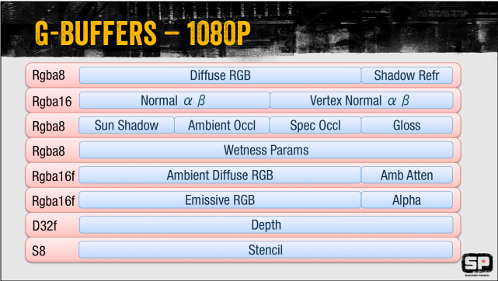
inFamous Second Son: G-Buffer
Notes:
More info here: http://suckerpunch.playstation.com/images/stories/GDC14_infamous_second_son_engine_postmortem.pdf

Slide 30
Actually light the scene
So far, nothing is actually on the screen
But the G-buffer has final surface data
Next step: “Render” each light as geometry
Ensures calculations for each light only occur on pixels they could affect
Use geometry that matches the light’s shape
Full-screen quads for directional lights
Spheres for point lights
Cones for spot lights

Slide 31
Rendering the lights
When rendering each light:
Sample the G-Buffer at the current pixel
Perform only this light’s calculations
Output this light’s contribution to that pixel
Based on surface normal and material properties
Can do shadow mapping here too
Use additive blending so the scene gets brighter where more lights overlap

Slide 32
Final combine
Combine the diffuse color (albedo) at a pixel with the light contribution at that pixel
Other effects can be calculated at this point
Fog
Bloom/Glow
Screen-Space Ambient Occlusion
Etc.

Slide 33
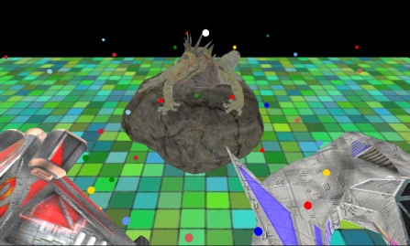
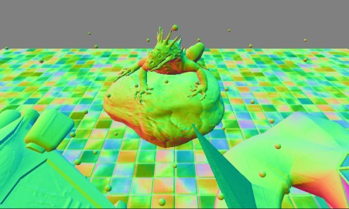

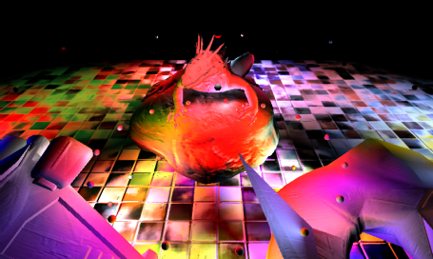
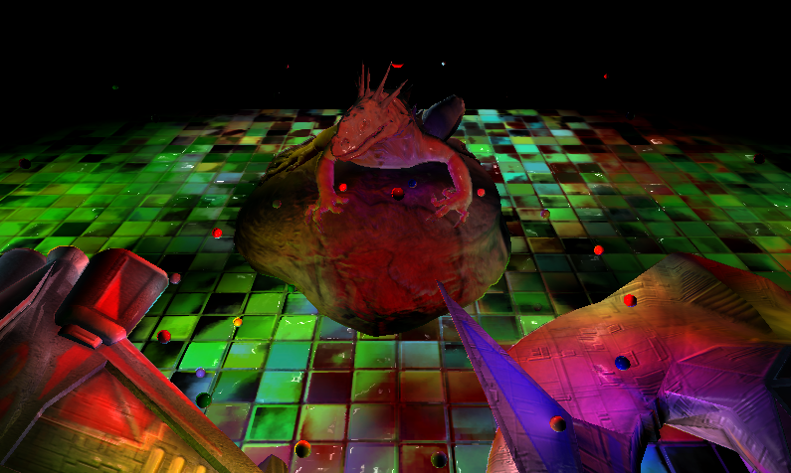
Full Example
Colors
Normals
Depth
Lights
Combined

Slide 34
Disadvantages
Memory use
G-buffer can be quite large for a 1080p game
Limited types of materials
More material information means larger G-Buffers
Transparency (or lack there of)
Deferred lighting lights the closest surface
Does not work with transparency!
Solution: Defer all opaque surfaces, then forward render all transparent surfaces afterwards

Slide 35
Other deferred techniques?
Deferred Lighting
Also known as Lighting Pre-Pass
Similar to deferred shading
Uses 3 passes instead of 2
Smaller G-buffer, but more “rendering”
Forward+ Rendering
“Tile-based forward rendering”
Uses compute shaders to generate light lists
http://www.slideshare.net/takahiroharada/forward-34779335

